Slide 1

Diabetes Prediction (DIABETELLER)
Minor Project Report
Submitted by:
1. Gumutch Mishra 191112009
2. Kunal Thite 191112015
3. Harshit Prajapati 191112020
4. Tanish Rangnekar 191112058
Under the Guidance of
Dr. Jaytrilok Choudhary
DEPARTMENT OF COMPUTER SCIENCE AND ENGINEERING

Slide 2
Content
1.Introduction………………………………………………………………………..……………9
2.Literature Review and survey…………………………………………………..…..11
3.Gaps identified…………………………………………………………….………………..15
4. Proposed Work and Methodology………………………..……………………17
4.1 Proposed Work………………………………...…………………………17
4.2 Methodology………………………………………………………………..19
5. Results and Discussions…………………….…………………………..………….39
6. Conclusion…………………………………………………………………………………...40
7. References…………………………………………………………………………………...41

Slide 3
Introduction
Diabetes mellitus (DM) is a metabolic disease, involving inappropriately elevated blood glucose levels and is a significant public health problem which is increasing at an unprecedented rate. By 2025, the prevalence of diabetes is projected to be 6.3%, which is a 24.0% increase compared with 2003. Nearly 2-5 million patients every year are said to lose their lives due to diabetes. It is estimated that by the year 2045 this will rise to 629 million. Predicting the disease at the early stage of life can save valuable human resources. Age, hereditary diabetes, obesity, lack of exercise, high blood pressure etc are all possible causes of diabetes mellitus. Diabetes mellitus is generally classified into 3 major types. Type-1, Type-2 ,Gestational Diabetes.
The proposed project provides a method to help future diabetic patients by using collected data from various medical and research clinics, analysing it and using it to develop a prediction model in order to attempt to find quicker and more efficient techniques of diagnosing the disease, leading to timely treatment of the patients. Current data models have not had great accuracy regarding the same and this project attempts to fix those gaps and give more concrete and consistent results.

Slide 4
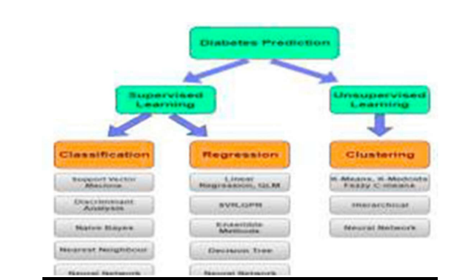
Related Work:
According to research work performed here, the Pima Indian diabetic database (PIDD) at the UCI Machine Learning Lab has been thoroughly tested using different data mining algorithms to predict their accuracy in diabetic status from a collection of individuals. Out of the total of 392 complete cases, they ended up with a 65.1% accuracy when trying to predict the non diabetic individuals. With the usage of ROSETTA software , a data mining predictive tool had been applied from the rough sets to PIDD. The accuracy of predicting diabetic status on the PIDD was an impressive 82.6% on the initial random sample, which exceeds the previously used machine learning algorithms that ranged from 66-81%.

Slide 5
Gaps Identified
As we all know the drastic increase in the rate of people suffering from diabetes in the previous 15 years. Present trending human lifestyle is the main reason behind growth in diabetes which we can also see in various recent research.
Gaps that we found are:
1. In various causes, false-negative type in which a patient in reality is already a diabetic patient but test results are showing that the person is not having diabetes.
2. Second cause is false-positive type. Which is opposite of false-negative type.
3. Unclassifiable type is that type of cause in which a system cannot diagnose a given case. Due to those errors in diagnosis may lead to unnecessary treatments or no treatments at all when required.

Slide 6
Reason of Gaps:
1. Lack of including lifestyle (diet plan, physical activity, Job profile and sleeping status) in data.
2. Lack of using few ML algorithms in model.

Slide 7
Proposed Work
After looking various available models, we decided to develop a user-friendly GUI based Application which would be able to full fill all above mentioned Gaps.
Our Project has two phases: -
1. Model building part.
2. User interface part.
# Model building part---
we are supposed to make, will calculate the probabilities by using different Machine Learning Algorithms and taking the mean of all the values because each algorithm has its own set of Advantages and Disadvantages. So it is more definitive to take the mean of all such values so that chances of error will be reduced.

Slide 8
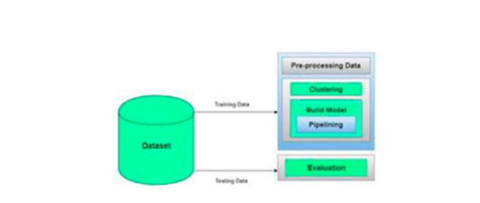
This model has five different modules. These modules include:
i. Dataset Collection
ii. Data Pre-processing
iii. Clustering
iv. Build Model
v. Evaluation
After evaluating through each model, whose detailing will be given in the Methodology Section, we will figure out the
Result and Conclusion, such that a person if diagnosed with diabetes can start treatment as soon as possible.

Slide 9
USER INTERFACE:
(A). In user interface user have to insert following data-
1. Gender 2. Num. of Pregnancies
3. Glucose level (FPG, PPBS, CGTT, RPT) 4. Blood Pressure
5. Skin Thickness 6. Weight
7. Height 8. Age
9. Race 10. Diabetic Pedigree
11. Diet Habit 12. Physical Activity
13. Job Profile 14. Sleeping habit
(B). Output-
Diabetic-> if yes, what we have to change in lifestyle to decrease it somewhat.
if no, what is future risk and how can be reduce its chances.

Slide 10
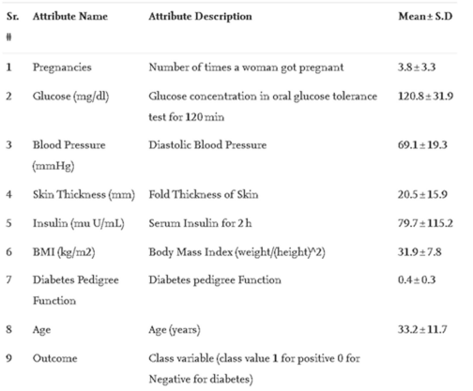
Methodology:
In this section we will be describing each and every module, each and every algorithm in detail that is needed for our project.

Slide 11
Dataset Collection:
In this module it is seen to include data collection and to understand the data to study the specific trends and unique patterns which helps in prediction and evaluating the results. For Training Dataset we will take PIMA India Diabetes Database and For testing dataset we will user's data.

Slide 12
Data Pre-processing:
This phase of the model handles inconsistent data in order to get more accurate and precise results. This dataset contains missing values. So we imputed missing values for a few selected attributes like Glucose level, Blood Pressure, Skin Thickness, BMI and Age because these attributes cannot have values zero. Then we have scalize our dataset to standardized all values.

Slide 13
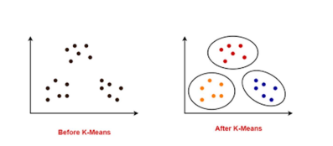
Clustering
In this section, we have implemented K-means clustering on our dataset to classify the patient to be either a diabetic or nondiabetic . Before performing K-means clustering on our model, highly correlated,which have no relation at all, attributes were found which were, Glucose and Age.So K-means clustering was performed on these two attributes. After implementation of this clustering we got class labels which is from values o or 1 for each of our records.

Slide 14
Algorithm
Algorithm:
- Take the no of clusters(K) and also obtain the data points
- Put the centroids for eg c_1, c_2, ..... c_k randomly
- Next Two Steps should be repeated for Fixed No of Iterations
-For each data point x_i:
-Find the nearest centroid(c_1, c_2 ,..c_k)
-Assign the point to that cluster
-For each cluster j = 1..k
- New_centroid = Mean(m) of all points given to cluster
-End

Slide 15
Model Building:
This phase is one of utter importance as it includes model building for prediction of diabetes. In this we make use of multiple different types of machine learning algorithms.These algorithms include Support Vector Classifier ,Linear Discriminant Analysis algorithm, Random Forest Classifier, Decision Tree Classifier, Extra Tree Classifier, daBoost algorithm, Logistic Regression, K-Nearest Neighbour, Gaussian Naïve Bayes, Bagging algorithm, Gradient Boost Classifier, Perceptron.

Slide 16
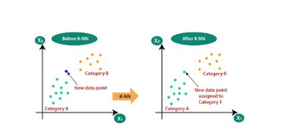
MACHINE LEARNING ALGORITHMS TESTED
1) K Nearest Neighbour Algorithm (KNN):
K-Nearest Neighbour is the simplest Machine Learning algorithm. It is based on the Supervised Learning technique.
The K-Nearest Neighbour algorithm is seen to adopt the similarity among the new data case and available cases and it places the new case into the most similar of the available categories.

Slide 17
2) Decision Tree Classifier (DTC):
Decision Trees are a category of Supervised Machine Learning (that explain what the input is and what the corresponding output is in the training data). In the decision tree, data is continuously split according to a certain parameter. The tree can be explained by 2 entities, namely decision nodes and leaves. The leaves are the decisions (final) outcomes and the decision nodes are where the data is split.
Mainly there are two types of Decision Trees:
1. Classification trees (Yes/No types):-
In some cases the answer could be “Yes” or “No” . Here the decision variable is Categorical.
2. Regression trees (Continuous data types):- The decision or the outcome variable is Continuous, for example a number like 123.

Slide 18
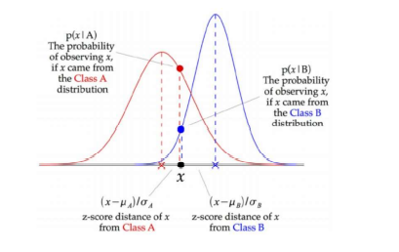
3) Gausssian Naïve Bayes (Gaussian NB):
When we are working with the continuous data,data which is not in an interval a consideration is always made that the continuous values associated with each of class are distributed or scattered according to a normal (or Gaussian) distribution. GNB Classifier is easy and fast to predict the class of test data.

Slide 19
4) Linear Discriminant Analysis (LDA):
LDA is acronym of Linear Discriminant Analysis, which is a dimensionality reduction technique that is commonly used for supervised Machine Learning classification problems. LDA is used for. separating two or more classes. LDA is used to project the features in higher dimension space for e.g. 2D into a lower dimension space like 1D. It is used in order to avoid curse of dimensionality and reduce resources and cost reduction.

Slide 20
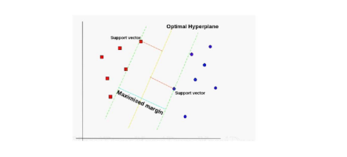
5) Support Vector Machine (SVC):
Support Vector Machine (SVM) is a very popular Machine Learning algorithm. It is used in both Classification and Regression. SVM is the same as Linear Regression (y= wx+b). In SVR, this straight line is referred to as a hyperplane. Data points on either side of the hyperplane which are closest to the optimal hyperplane are called Support Vectors. That is used to plot the boundary line. Goal of SVC is to create best Line or decision boundary that can segregate n-dimensional space into classes.

Slide 21
6) Linear SVC:
The SVC method uses a linear kernel function for classification. It performs good with a large number of samples. It is called Linear because ratio of input to output data is always constant.

Slide 22
7) Adaboost:
AdaBoost algorithm, in which Ada stands for Adaptive ,It is a Boosting algorithm which is used as an Ensemble Method in Machine Learning. AdaBoost is called Adaptive Boosting because the weights are assigned to each of the instance, in which with higher weights assigned to incorrectly classified instances. Boosting helps to reduce bias as well as variance for supervised learning of Machine Learning Algorithms. It works on the principle that instances are growing sequentially.Besides first, each subsequent instance is connected from previously connected instances. Simply, weak learners are converted into strong ones.

Slide 23
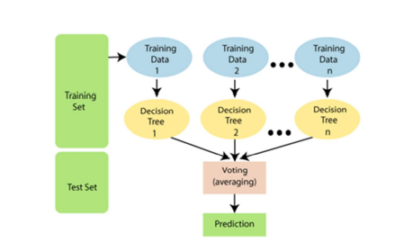
8) Random Forest Classifier:
Random Forest classifier is a machine learning algorithm that belongs to the supervised learning technique. It can be used for classification and Regression problems both in ML. It based on the concept of ensemble learning, which is a process of combining multiple classifiers to solve a complex problem and to improve the performance of the model.

Slide 24
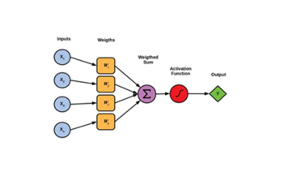
9) Perceptron:
The Perceptron model is a supervised learning algorithm of binary classifiers. A one neuron, the perceptron model, detects whether any function is an input or not and classifies them in either of the classes.

Slide 25
10) Extra Tree Classifier:
This section involves a unique type of ensemble learning technique which is known as Extra Trees Classifier. This ETC combines the results of multiple de-correlated decision trees which have been collected in a “forest” in order to output it’s classification result. From its theory it can be seen as being very similar to that of the Random Forest Classifier but its difference can be seen from the technique of the construction of the decision trees in the forest.

Slide 26
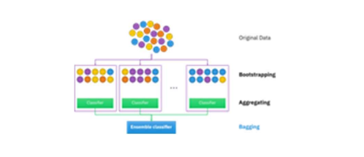
11) Bagging:
This ensemble learning method known as bagging, also called the bootstrap aggregation,is commonly used to reduce variance that is found inside of noisy datasets.
In the process of bagging, 2 random data sets are chosen with one being the replacement. Which means that the one data point is able to be picked more than once.

Slide 27
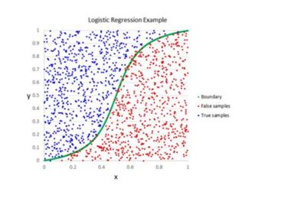
12) Logistic regression:
This is known as one of the most utilized and important ML algorithms, and is said to come under the Predictive Models. Logistic regression is utilized using a given number of independent variables in order to predict the categorical dependent variable.
Logistic regression is able to predict the categorical dependent variable. Therefore the outcome must be a discrete value. It can be either 0 or 1,Yes or No, True or False, etc. but instead of giving 0 and 1, it values in range of (0,1).

Slide 28
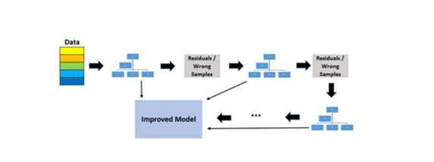
13) Gradient Boost Classifier:
We can say that Gradient boosting classifiers are a group of machine learning algorithms but not a single one that combine many weak learning models together to create a strong predictive model which can be used that strong model is known as Improved Model. When we are doing Gradient Boosting generally Decision Tree is used to build the model.

Slide 29
Evaluation:
This was the last step of our prediction model. Now we evaluate the prediction results of our model using various parameters like classification accuracy, confusion matrix and f1-score

Slide 30
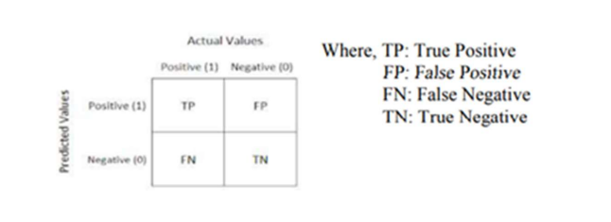
Classification Accuracy:
Confusion Matrix:
Accuray is defined is the ratio of the no of correct predictions to the total number of input samples given.
𝐴ccuracy = No. of right Predictions /Total no. of predictions made for our model
It will give us a 2-D Array(Matrix) as output and describes the Overall performance of the model.
Accuracy for the matrix can be calculated by the following Formula: Accuracy = ((𝑇P+𝐹N))/ 𝑁 Where, N:Total number of samples

Slide 31
F1 Score:
Precision:
It is used to measure the test’s accuracy.It is the Harmonic Mean between precision and recall.
The range for F1 Score is somewhat between 0 to 1. It tells us the precision of our model and also how robust our model is. 𝐹1 = (2 ∗ 1 /((1/Precision)+(1/recall)))
Precision is defined as the ratio of the no of correct positive results to the no of positive results predicted by our model .
Precision= (𝑇P/ (𝑇P + 𝐹P))

Slide 32
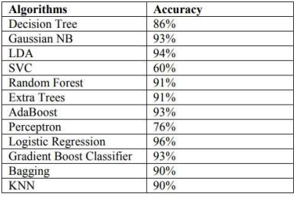
Recall:
Recall is defined as the ratio of the no of correct positive results to the no of all the relevant samples.
Recall= (𝑇P/ (𝑇P + 𝐹N))
After Calculations We get:

Slide 33
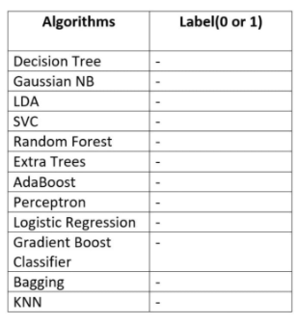
Results:
After applying various Machine Learning Algorithms on dataset we got individual outcomes of all algorithms.
Each algorithms have their own limitation so we cannot rely on any particular algorithm for our final result.
We finally conclude by taking maximum of outcome we got.
Final outcome =(Yes/No)

Slide 34
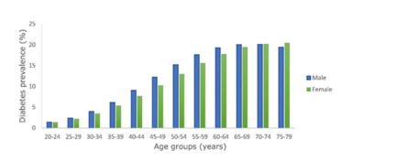
Conclusion
In this project we are implementing multiple different Machine learning algorithms and trying to fill the gaps present in current model of detecting diabetes.
We are aiming to make an application which will enable people to check the probability of suffering from diabetes in the future. This is accomplished by entering some of the basic information such as Age, glucose, blood pressure, weight, height etc.
Our primary goal is to try to make people aware and minimize the time which is needed in order to diagnose the possibility of diabetes in the future.

Slide 35
REFERENCES
[1] One of the cause said by Eurek alert, "Insufficient sleep may be reason to increased diabetes risk," July 11, 2010
[2] Bhatt K., Dalal P., Panwar A. said that , “A Cluster Centres Initialization Method for Clustering Categorical Data Using Genetic Algorithm” in International Journal of Digital Application & Contemporary research, 2013, Volume-2 Issue-1.,for clusterization.
[3] Huang, Zhexue. "A Fast-Clustering Algorithm to Cluster Very Large Categorical Data Sets in Data Mining." DMKD. 1997.
[4]Diabetes Prediction using Machine Learning Algorithms Aishwarya Mujumdara , Dr. Vaidehi Vb
[5] A Data Mining Method for the Diagnosis of Diabetes suggested using Random Forest Classifier Ms Mani Butwall M. Tech. Scholar Computer Science Department of Sushila Devi Bansal College of Technology, Indore (MP) Ms. Shraddha Kumar Asst. Professor Computer Science Department Sushila Devi Bansal College of Technology, Indore (MP)
[6] DIAGNOSIS OF DIABETES USING CLASSIFICATION MINING TECHNIQUES Aiswarya Iyer, S. Jeyalatha and Ronak Sumbaly
[7] All The Images ,data,graphs and table are taken from Google
[8] Geeks for geeks machine Learning
[9] Idea of algorithms from wikipedia Page

Slide 36
[10] Overview of Data Analysis from Tutrorials Point
[11] Data Sciene Techniques From Wikipedia Page.
[12]https://www.niddk.nih.gov/health-information/diabetes/overview/what-is-diabetes#:~:text=Diabetes+is+a+disease+that,to+be+used+for+energy
[13]https://drive.google.com/file/d/1IRlJBa4KxDzQr0u1_MuZ7h5Gz7-PCnOw/view?usp=sharing
[14]https://drive.google.com/file/d/1b0kcXhYsJfUuVqbdkhxyOhS8kUuuToUz/view?usp=sharing
[15]https://drive.google.com/file/d/1f0Te1STxo1UpLr_q_bEh6ob3_0E_XJiB/view?usp=sharing
[16] https://drive.google.com/file/d/1X2YwiktLYV10zyuMGwB2L0-pOR9woik_/view?usp=sharing
[17] https://ieeexplore.ieee.org/document/9441935

Slide 37
Thank you !
Diabetes Prediction (DIABETELLER) Minor Project Created by :
Gumutch Mishra
Kunal Thite
Harshit Prajapati
Tanish Rangnekar

